Slide 1
IN THE NAME OF ALLAH THE MOST BENEFICENT AND MOST MERCIFUL

Slide 2
Population Explosion
Rapidly increasing population is the most gigantic, formidable and intractable problem which the world faces today. Everybody knows that the world of today is said to be over populated. The alarming increase in the world population poses certain crucial economic, political and social problems.
A country becomes over populated when its resources fail to cope with its requirements and its natural resources are insufficient to meet the needs of the people.
The very basic reason for the rapid population increase is scientific and technological advancement, which saves thousands of lives each year, that previously were digested by disease, epidemics and natural disasters.
The world is becoming more and more competitive because of rampant population multiplication. We have limited resources. As population increases, the struggle for the allocation of these scarce resources becomes severe and intense.
This phenomenon gives rise to conflict and confrontation in every field of life. "The struggle for existence" becomes hard with every new born baby, and nature's selection for better also becomes ruthless

Slide 3
The rate of increase of population during the last 50 years was amazingly rapid-and the world average rests around 1.5 per cent per annum. The population rate in some countries, especially the less developed ones increased as high as 3 to 4 percent while in others as part of the developed and prosperous world rose only from 1 to 2 percent.
GLOBAL PERSPECTIVE
The world population did not cause any concern until the industrial revolution took place in Europe.
The total world population did not reach one billion mark until the beginning of the 19th century. From A.D.I to 1750, the world population is reported to have grown at an annual rate of 0.05 per cent.
It grew at a rate of 0.5 per cent per annum during 1750 to 1850 and 0.8 per cent per annum between 1900 to 1950.

Slide 4
The 18th and the 19th centuries, however, ushered in a demographic revolution in Europe as a result of the decline in the mortality rate caused by phenomenal advancement in medical research.
Thus the world population which stood at 470 million in 1650 had risen to 5,000 million by 1989 and is expected to reach 9,000 million marks by the end of the 2099.
The average rate of population increase now ranges between 2.3 per cent to 2.9 per cent per annum.
It is now an established fact that several developing countries, such as India, Bangladesh, South Korea 'and Thailand which introduced the family planning services around the same time as Pakistan are far ahead in their fertility reduction efforts.

Slide 5
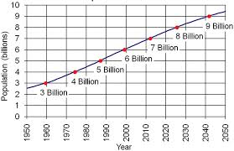

Slide 6
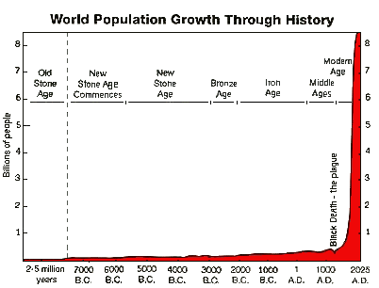

Slide 7
MALTHUS THEORY OF POPULATION
Malthus, a well known economist, gave his famous theory of population.
According to him the population of the world increases in geometric progression like 2, 4, 8, 16 etc. while the resources to meet the demand of the population increase in arithmetic progression like 1, 2, 3, 4, etc.
So there are more people and less resources in the world. At that time nature controls the population by its own way i.e. floods, earthquakes, diseases and wars.
This theory was subsequently falsified in Europe but is still valid for developing countries.

Slide 8
MAIN CAUSES OF OVER POPULATION.
◆ Increase in fertility rate
◆ control of the fatal diseases
◆ Infant death rate curtailed
◆ Lack of recreational facilities
◆ Male dominated society
◆ Early marriages
◆ Low status of women
◆ Joint family system
◆ Warm climate
◆ Illiteracy
◆ False religious practices
◆ Polygamy

Slide 9
EFFECTS OF POPULATION GROWTH
◆ Economic' Development. The rapidly rising population affects the economic development in the following ways:‑
First, a greater percentage of the scarce resources is diverted to meet the higher consumption needs of the masses and little capital is saved for investment.
Second, the pressure, of population makes the agricultural holding uneconomic as it is divided and sub-divided into families and sub-families, and the yield per hector decreases.
Third, the fast growing population creates economic and social problems such as power, housing, transport, education, health, urbanization within limited resources.
◆ Per Capita Income. The rapidly rising population nullifies the increase made in the national income and leads to decline in the per capita income of the country concerned.
◆ Standard of living. The fast moving population reduces per capita income and increases the prices of goods. As the rise in the demand affects the supply of various goods, it lowers down the quality of life of the people. 35 per cent of population lives below poverty in Pakistan.
◆ Agricultural Development. The fast growing population with inelastic supply of labour puts pressure on land, makes difficult the use of the improved techniques of agriculture, increases the number of landless workers, retards capital formation in agriculture sector and creates problem of low productivity and food shortage. Thus pressure on population makes the agricultural development quite stagnant.

Slide 10
Employment. A rapidly increasing population reduces income, savings and investment in the country. The decline in capital leads. to unemployment and underemployment. In Pakistan, the ratio of unemployment is 25 per cent in cities and double in rural areas and there is one million increase in it annually.
Conflicts and Confrontations. The society becomes more competitive, ultimately giving rise to conflicts and confrontations; the crisis of Karachi has its roots in this problem.
Social Infrastructure. In a country having, a rapid rate of increase of population, huge investment is required in social infrastructure. Due to scarcity of capital, it is not possible to provide full facilities of education, health, medical, transport and housing etc. to the population. As a result of over crowding everywhere, the quality of their services goes down. Public sector as well as private sector cannot build the social infrastructure.
Labour Force. With a rapid rise in population growth, the labour force tends to increase. It women also seek employment along with men, then unemployment and underemployment 'decrease both in rural and urban areas. Labour force in Pakistan is 36 million of which 6 million is unemployed. Among them, 51 per cent of labour force is in agriculture, 13 per cent in industry, 2 per cent in trade, 6 per cent in construction and 1 l per cent in different sectors.

Slide 11
Capital Formation. A fast rate of increase of population reduces incomes, lowers savings and investments and thus retards capital formations.
Environment. The rapid population growth creates air, water and noise pollution in cities and towns and thus leads to environmental damage. It is pity that we establish new industries and build new colonies by cleaning the forests, and destroying natural environment at the cost of our health.

Slide 12
What is population planning?
Population planning primarily aims at an 'optimum' size of population for a country.
It does not necessarily mean a reduction in the rate of population increase as is generally understood and commonly true in the case of UDCs. (e.g. In France population is actively encouraged through generous family planning allowance).
It rather strives for a size of population which is capable to fully exploit available and potential resources of a country.
The objective is to match the size of a population with the available resources.
It is extremely important that population planning is looked upon as a part of equitable economic development, ensuring socio economic justice.

Slide 13
Population Planning in Islam.
According to some conservative Ulema, there is no ground for population planning in Islam.
They say that Muslims should not indulge in population planning which is against the law of nature. But this view is not correct.
It is true that children are a blessing of God but Islam teaches us to cut our coat according to our cloth. If we have not as many resources to feed more children so it is better to have a few.
In ancient Arabia, before the Holy Prophet, the system of family planning was prevalent.
The Arabs usually adopted the method of "Azal" i.e.' to keep ejaculation out.
This system was continued by the companions of the Holy Prophet (PBUH) and he did not stop them. So, when there is over population, it is permitted.

Slide 14
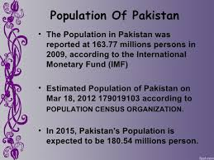

Slide 15
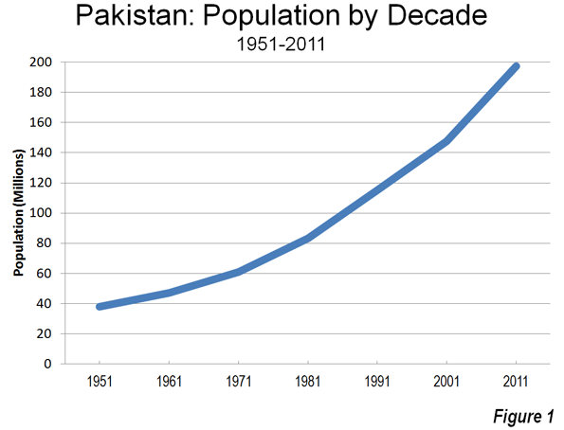

Slide 16
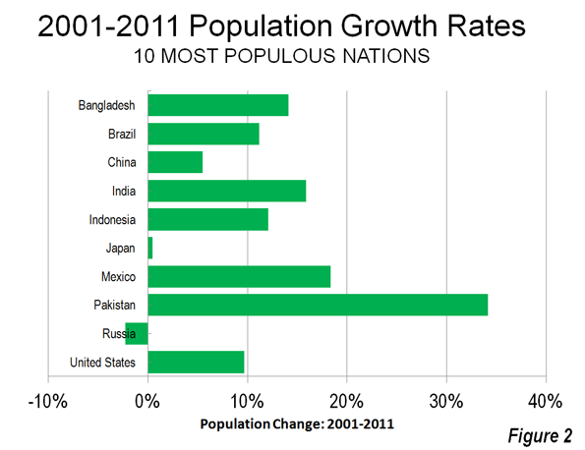

Slide 17
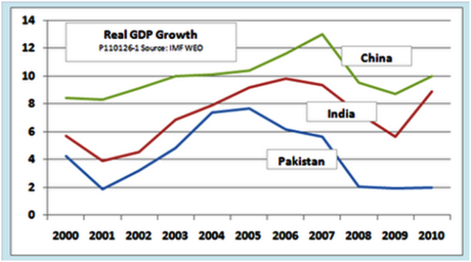

Slide 18
What is to be done more?
As the dragon of over population is digesting our already scarce resources at a massive rate. So our government should go for the remedial measures. In this regard the following suggestions may prove very fruitful and result oriented.
Some of our orthodox ulemmas show extreme antipathy towards population planning. They consider it anti-Islamic. Infact the main aim of population planning is to optimize population. It brings population level equals to the resources of that country.
Arabs before Islam practised population planning. The concept of Azal (keep the ejaculation out) was prevalent there. Some of the companions of the Holy Prophet PBUH also adopted the method of Azal and the Holy Prophert did not stop them doing so.
Thus the ulemmas must propagate the concept of Azal and should not stop the people to act upon the population planning programme.

Slide 19
The girls of today’s will become the mothers of future. Therefore, by educating women about the disastrous effects of population the population growth rate can be reduced.
Propulsive campaigns must be launched in favor of small family norms. This campaign must aim at disseminating the need of small family and hazards of large family.
In the syllabi of intermediate and graduation some essays about the threats of population explosion must be added in order to enhance their pulchritude about the intensity of the problem.
Seminars, symposiums and workshops should be held in different places about the detrimental social, economic and cultural effects of population explosion.

Slide 20
Effective, technical support must be provided to the non-governmental organizations (NGO’s) to make them active and efficient. These NGO’s can inculcate people to have a small family.
Population planning committee at local, district and provincial level must be activated. All the ministries and departments must take active part in order to make these committees more active and effective.
The electronic media should also be utilized. The advertisements through television might convey the message without factitiousness. Thus, media can change the immutable view point of people about having large family very easily.
A day should be celebrated at National level with the name of “National Population Day”. This should be done on the pattern of the “world population Day” which is being celebrated on the 11th July each year. Thus, these types of activities play an important role increasing acquaintance about the subject matter.

Slide 21
REMOTE SENSING AND GIS
Remote sensing is the acquisition of information about an object or phenomenon without making physical contact with the object and thus in contrast to on site observation.
Remote sensing is a sub field of Geography . In modern usage, the term generally refers to the use of aerial sensor technologies to detect and classify objects on Earth (both on the surface, and in the atmosphere and oceans) by means of propagated signals (e.g. electromagnetic radiation).

Slide 22
It may be split into active remote sensing (when a signal is first emitted from aircraft or satellites)or passive (e.g. sunlight) when information is merely recorded.
Passive sensors gather radiation that is emitted or reflected by the object or surrounding areas. Reflected sunlight is the most common source of radiation measured by passive sensors. Examples of passive remote sensors include film photography, infrared, charge-coupled devices, and radiometers.
Active collection, on the other hand, emits energy in order to scan objects and areas whereupon a sensor then detects and measures the radiation that is reflected or backscattered from the target.
RADAR and LiDAR are examples of active remote sensing where the time delay between emission and return is measured, establishing the location, speed and direction of an object.

Slide 23
RADAR and LiDAR are examples of active remote sensing where the time delay between emission and return is measured, establishing the location, speed and direction of an object.

Slide 24
